Slide 1

Presentation
On
Book Depot Management
Presented By:-
Kirti Gupta (13BCS1130)
Kushalpreet Kaur (13BCS1138)
Lovepreet Singh(13BCS1142)
Notes:
Expect noting and you will never disappointed

Slide 2

INTRODUCTION
Book store management is designed to deal with the customer queries regarding information about different types of books. This is a System that matches the customer queries regarding the author, publishers, title, price, latest updates, storage information, upgrades etc. against the information stored in the centralized database.
Notes:
Expect noting and you will never disappointed

Slide 3

OBJECTIVE
Manage all the account details such as user name, phone numbers, address.
Maintain history of each customer
Capture, View and edit all user transactions.
View all the details of all the interactions made with the customer.
Notes:
Expect noting and you will never disappoint

Slide 4

SYSTEM REQUIREMENTS
S. No. | NAME | HARDWARE
1 | Processer | Platinum Dual Core(upgraded),Intel
2 | Processor Speed | More than 1.2Ghz
3 | RAM | 1GB
4 | Hard Disk Capacity | 40GB
5 | Monitor | SVGA colour monitor
S. No. | NAME | SOFTWARE
1 | Platform | Platform independent
2 | Development Language | JAVA(Front End)
3 | Database Tool | Wamp Server
Notes:
Expect noting and you will never disappointed

Slide 5
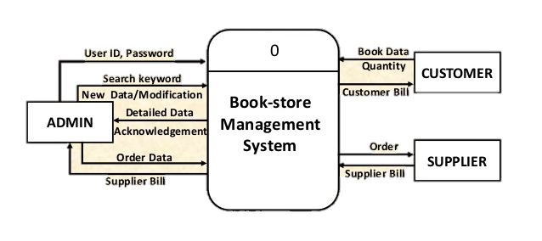
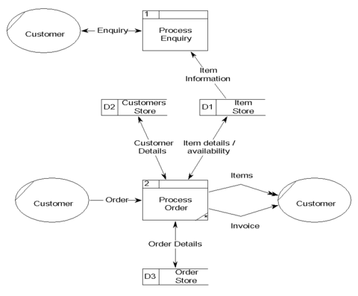
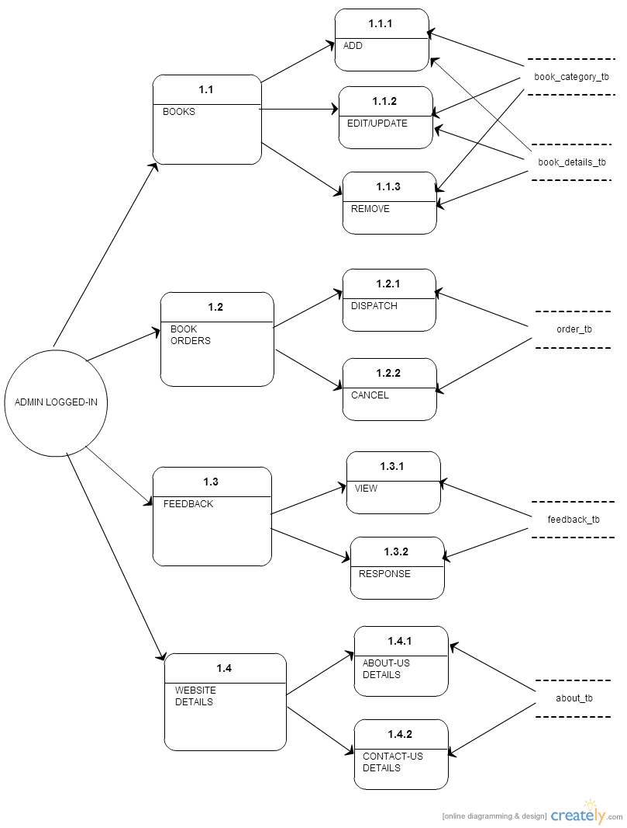
DFD
DFD Type 0
DFD Type 1
DFD Type 2
Notes:
Expect noting and you will never disappointed

Slide 6
STRUCTURAL DESIGN OF DATABASE :-
There are Three tables used in our software which are being created. One for Admin containing admin record one for Distributer and other for Login. containing all record of the book
Login Table
Login | Name of Columns | Data Types
 | Name | varchar(40)
 | Userid | varchar(40)
 | email | varchar(40)
 | password | varchar(40)
Notes:
Expect noting and you will never disappointed

Slide 7
Book Reg. Table
Create Shop | Name of Columns | Data Types
 | Store_name | varchar(30)
 | isbn_no | varchar(30)
 | book_name | varchar(30)
 | auther | varchar(30)
 | publisher | varchar(30)
 | mrp | int(30)
 | discount | double(30,4)
 | selling | double(30,4)
 | qunatity | int(30)
 | version | varchar(30)
 | alert | int(30)
Distributer Table
Distributer | Name of Columns | Data Types
 | name | varchar(30)
 | mobile | varchar(10)
 | email | varchar(30)
 | address | varchar(30)
 | account | int(30)
 | ifcs | int(30)
 | bname | varchar(30)
Notes:
Expect noting and you will never disappointed

Slide 8
STRUCTURAL DESIGN OF INTERFACE
There are following modules:-
Login
Signup
Book Registration
Distributor
Import
Out Bill
View Books
View Distributer
Notes:
Expect noting and you will never disappointed

Slide 9
PSEUDO CODE
Algorithm:-
1. Start
2. Login
3. Register the Book
4. Entre the detail about the distributer
5. Check the status of the book in the Search
6. Store the in bill from the distributer.
7. Generate the out bill for the customer.
8. End
Notes:
Expect noting and you will never disappointed

Slide 10
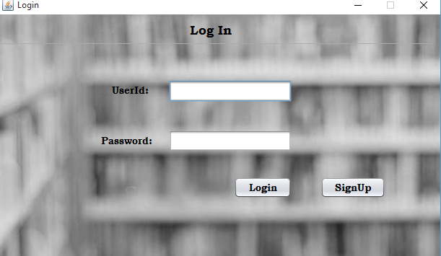
PROJECT (Screen Shot)
Notes:
Expect noting and you will never disappointed

Slide 11
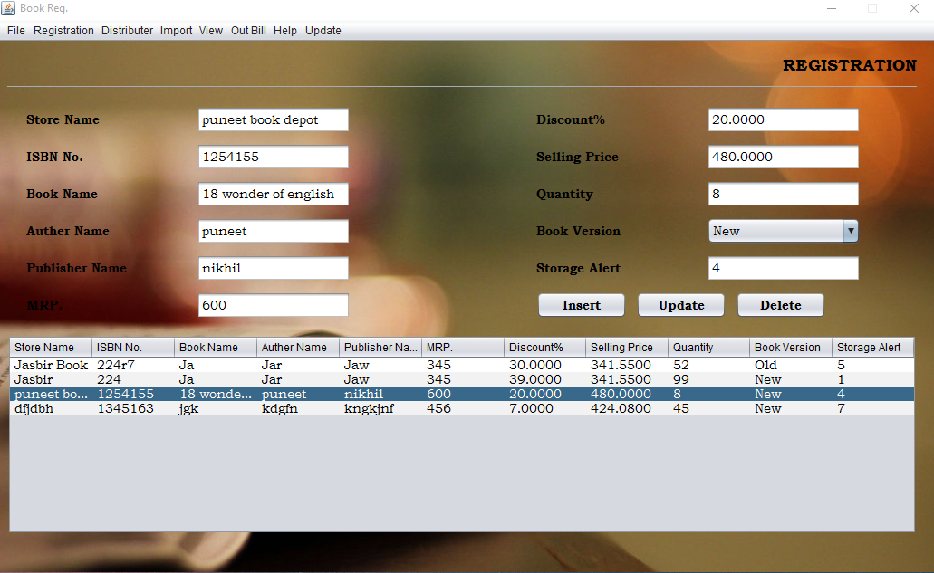
Notes:
Expect noting and you will never disappointed

Slide 12
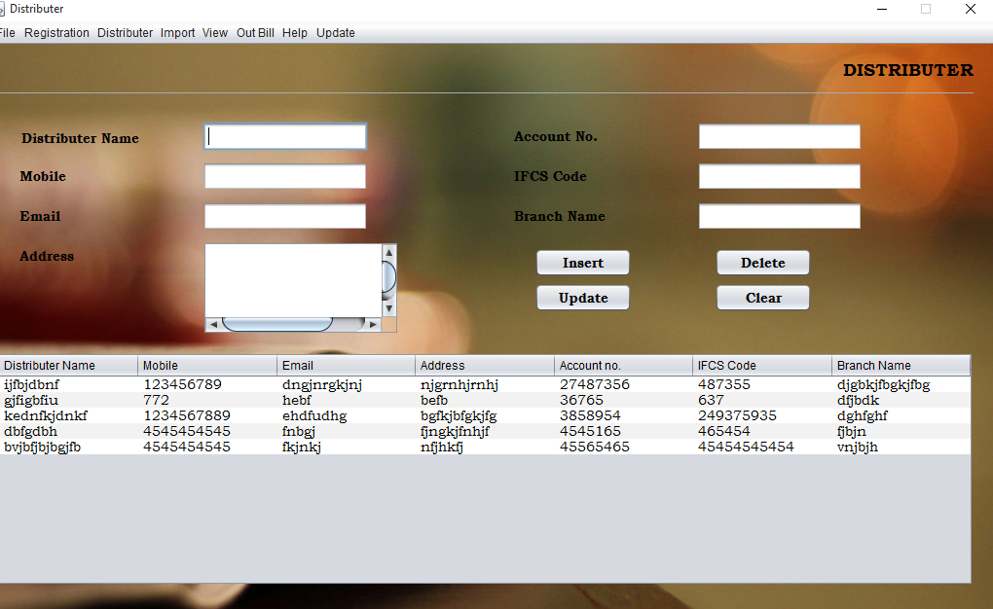
Notes:
Expect noting and you will never disappointed

Slide 13
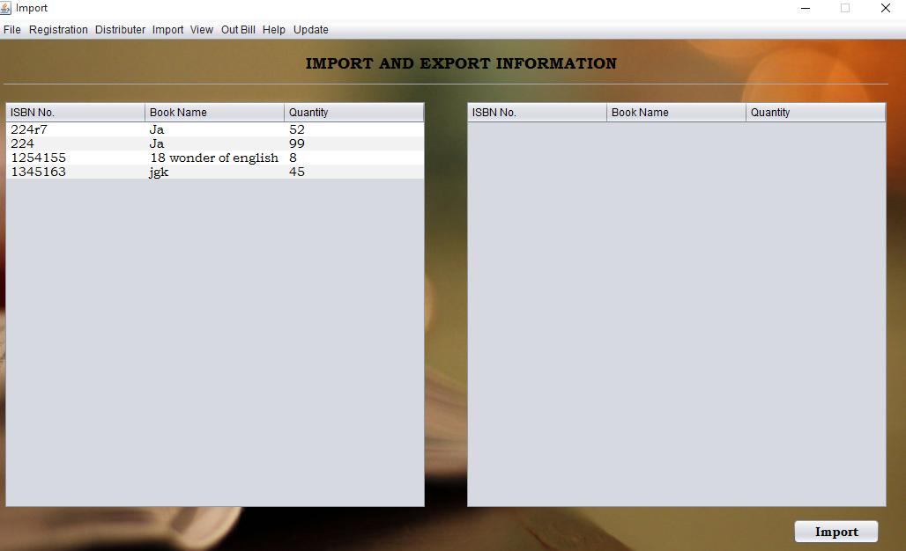
Notes:
Expect noting and you will never disappointed

Slide 14
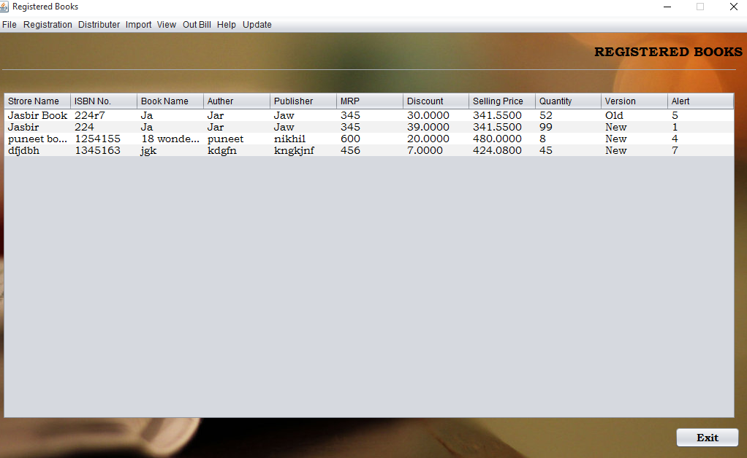
Notes:
Expect noting and you will never disappointed

Slide 15
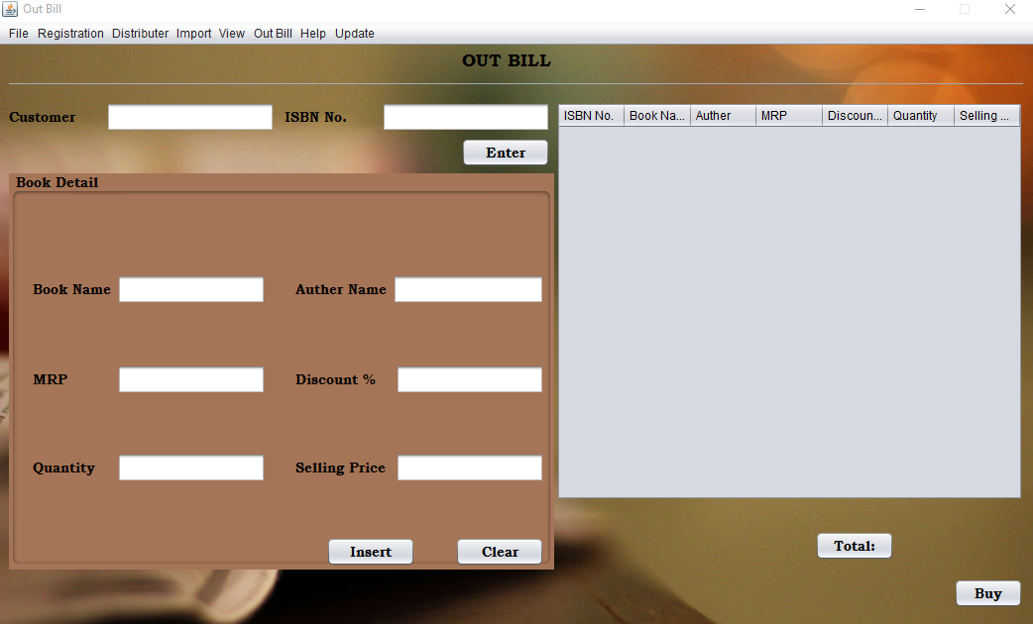
Notes:
Expect noting and you will never disappointed

Slide 16
BIBLIOGRAPHY
1. Java 2 -The Complete Reference 5Th Ed - Herbert Scheldt - 2002
2. www.javatpoint.com
3. www.javatutorial.com
Notes:
Expect noting and you will never disappointed

Slide 17

Notes:
Expect noting and you will never disappointed

